Slide 1
AMP Update and Briefing
Ellwood City, PA
August 1, 2016

Slide 2

Introduction of AMP

Slide 3
AMP and Its Members
American Municipal Power, Inc. (AMP) is a nonprofit wholesale power supplier and services provider for members across nine states
Formed in 1971, the AMP organization is headquartered in Columbus with approximately 180 employees at headquarters and generating facilities
Board of Trustees consists of 20 AMP members
  12 Board seats are elected by the members within their own service area; eight are elected at-large by all of the AMP members

Slide 4
Governance & Strategic Planning
AMP serves 133 municipal electric systems (members)
Ohio, Pennsylvania, Michigan, Virginia, Kentucky, West Virginia Maryland and Indiana, as well as the Delaware Municipal Electric Corporation
AMP member communities in PA – 29
Total # meters of PA AMP members – 61,998
  Average meters per member = 2,137
Ellwood City is the 4th largest PA municipal
  4,073 meters
  Average AMP member has 5,000 meters

Slide 5
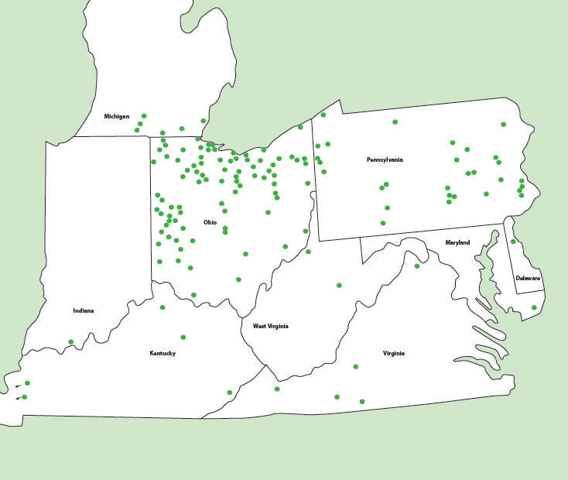
AMP Member Map

Slide 6
AMP Strengths
Financial strength
  Since 2000, all AMP construction project financing and entity ratings have been in the “A” category
    AMP is well regarded by rating agencies
  $750 million line of credit to provide underlying support
    Expandable to $1 billion
The Energy Authority (TEA) membership
  Nationally-recognized best practices entity
Projects-based organization
  Strategic generation asset development
  Members subscribe to projects of their choice
  No cross subsidies or cross defaults
  All projects overseen by participants committee

Slide 7
AMP
Member Energy Resource Mix (2007 – 2017)
2007
2017
Note:
- Member coal includes Paducah and Princeton’s Prairie State energy purchased
through KMPA
- Wind & Solar includes member contracted solar
- Hydro includes member owned hydro
- 2017 resource mix includes 60 MW of new solar
8

Slide 8
Member Power Portfolio Strategy
Diversify portfolio to mitigate risks
  Balance long and short term purchases:
    Long term provides hedge against rising prices
    Short term allows for opportunity to take advantage of lower prices
  Balance peaking, intermediate and base load resources
  Varied fuel resources and technologies
  Limit exposure to volatile energy, capacity, and transmission markets

Slide 9
Benefits of Public Power

Slide 10
Public Power Business Model
  Public Ownership
    Public power utilities are owned by and operated for the citizens they serve and therefore are accountable to their local owners.
  Local Control
    Local, independent regulation and governance gives utility policymakers greater agility in decision-making and protects the long-term viability of the utility, while permitting customer involvement in the process.
  Nonprofit Operations
    Community-owned electric utilities serve only the interest of their customers, avoiding conflicts between the interests of shareholders and customers because they are one and the same.
  Low-Cost Structure
    Public power utilities have access to lower cost tax-exempt financing and generally have stronger credit ratings than privately owned utilities.
  Customer Focused
    Community-owned electric utilities are dedicated to the singular mission of delivering the highest level of service and value to their customer-owners for the long term.

Slide 11
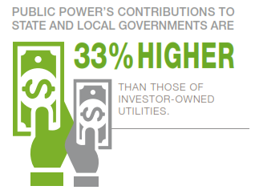
More on Public Power
Local Control
  Support Local Government
    Public power utilities provide a direct benefit to their communities in the form of payments and contributions to state and local government.
    Public power utilities make greater financial contributions to state and local governments than investor-owned utilities.
    Monies are transferred to the general fund which stay within the community and can be used at the discretion of the borough for things like economic development.

Slide 12
More on Public Power
Efficient System Operation
  Local Priorities
    When the community owns the utility, the community controls the utility’s priorities. Decisions about pricing electricity, building power plants, purchasing wholesale power and service policies are made locally and reflect the values and choices of the community.
  Ownership
    Public power communities receive another benefit: ownership itself. Ownership of the utility means local management and control over decisions involving investments, operations, maintenance, power supply choices and customer programs.
  Reliability
    Public power utilities have a strong record of focusing on core electric operations and delivering a reliable power supply. Because of their connection to customers, public power utilities are motivated to maintain the community’s assets to keep their local electric system operating continuously and efficiently.
      Outage Restoration
      Mutual Aid

Slide 13
Ellwood City’s Energy, Capacity and Transmission

Slide 14
Energy Terms
Watts (P) = Measurement of power. Rate at which energy is expended to do work
  (Volts x Amps = Watts)
Demand (kW) = Maximum amount of power consumed (1 hour, 15 min, instantaneous)
Energy (kWh) = Power produced or consumed over a given period of time
Capacity (kW) = Maximum output capability of power supply resource

Slide 15

Pricing of Power (Effective Rate)
  Demand Charges: fixed costs
  Examples:
    Mortgage, insurance premiums, fixed operating costs
  Member used 2 MW
    2,000 kW x $10.00 / kW-mo = $20,000
  Energy Charges: variable costs
  Examples:
    Fuel costs, O&M that varies with usage, energy purchases
  Member uses 2 MW for 500 hours (2 x 500 = 1,000 MWh)
    1,000 MWh x $30.00 / MWh = $30,000
  Effective rate : Total Dollars divided by MWh used
  $50,000 / 1,000 MWh
    $50.00 / MWh or 5.0 cents / kWh
Notes:
No change

Slide 16
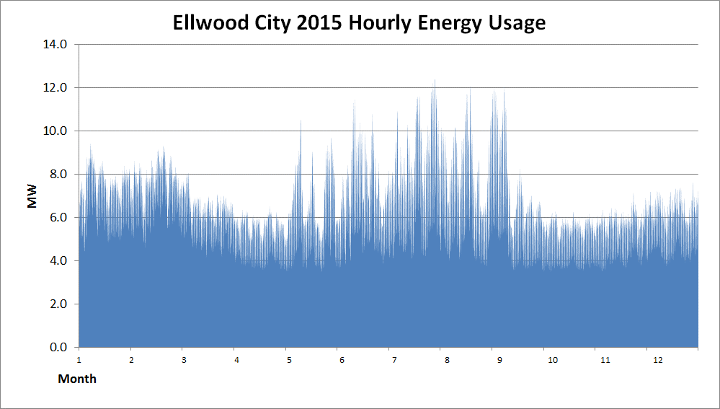
54,193,000 kWh
Notes:
On this slide, please change:
Muni name
Energy usage
Find this in S:\planning\key files\Forecasted Demand and Energy Graph All.xls
Change the Muni name in Cell B1
’11, ’12, and ’13 energy numbers will be in the column labeled “Energy” (column D) highlighted orange
’14 Actual plus Forecasted energy will be located in Cell F29
’15 Forecast will be located in Cell E30
Load growth comes from cell F3
Change bright green text to black

Slide 17
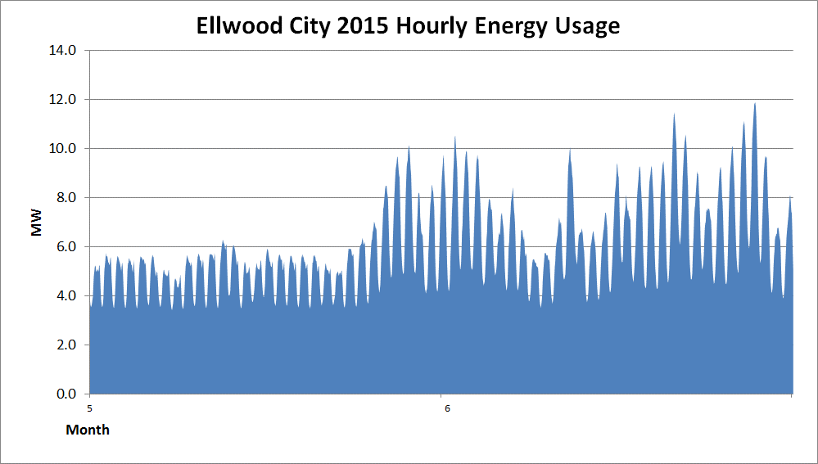
May and June 2016 Energy Usage
3,910,000 kWh – May (31 days)
4,857,000 kWh – June (30 days)
(Difference of 947,000 kWh)
May
June
Notes:
On this slide, please change:
Muni name
Energy usage
Find this in S:\planning\key files\Forecasted Demand and Energy Graph All.xls
Change the Muni name in Cell B1
’11, ’12, and ’13 energy numbers will be in the column labeled “Energy” (column D) highlighted orange
’14 Actual plus Forecasted energy will be located in Cell F29
’15 Forecast will be located in Cell E30
Load growth comes from cell F3
Change bright green text to black

Slide 18
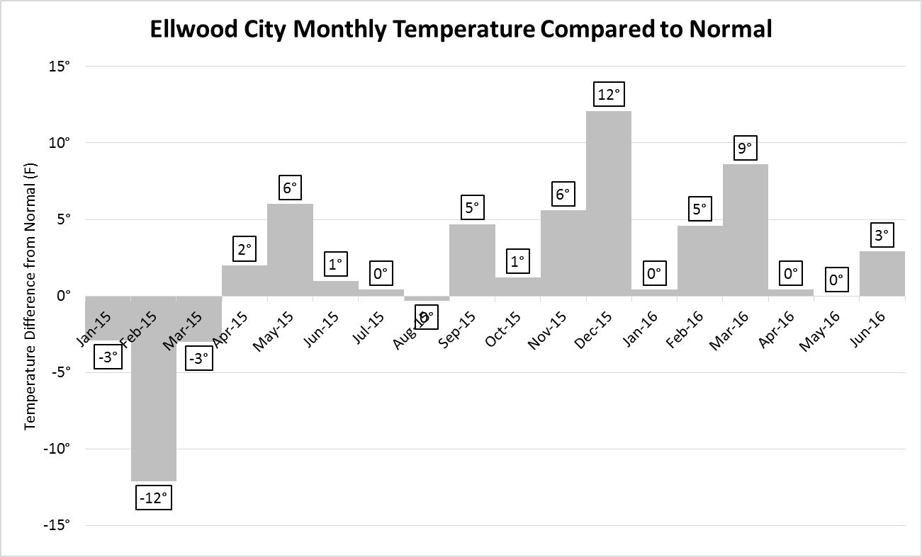

Slide 19
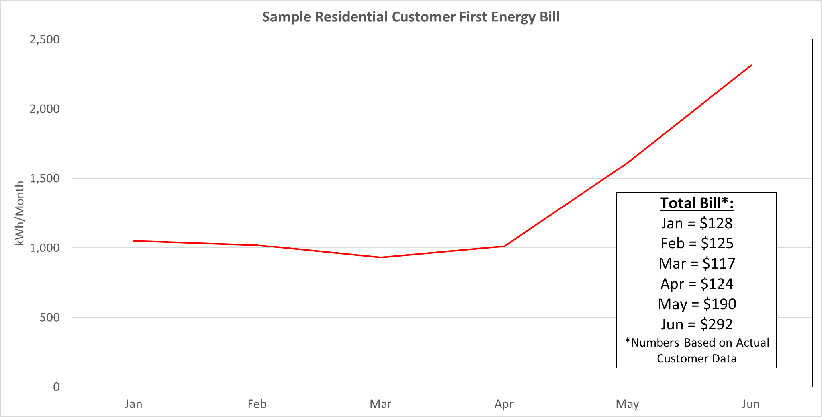

Slide 20
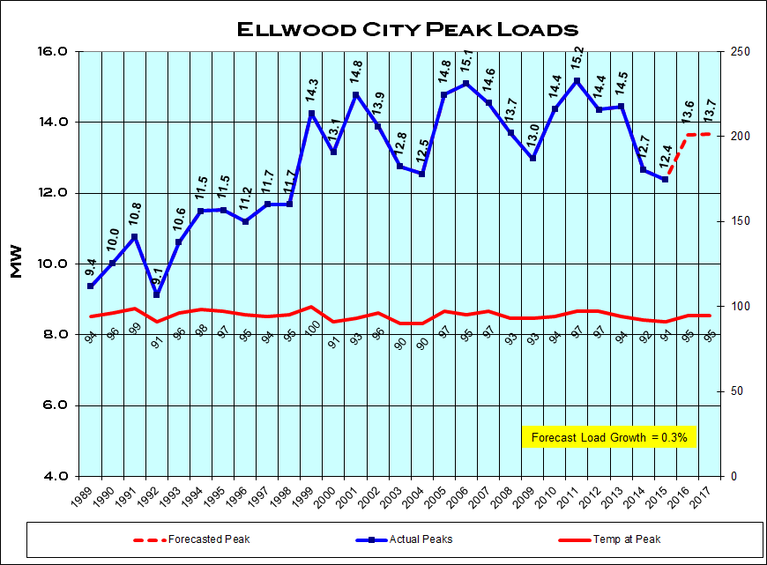
Notes:
On this slide, please change:
Graph
Find this in S:\PLANNING\Key Files\MasterChartsGDP.xls
On the “Chart Template” tab in cell C47, enter the name of the Muni and the graph should update.
Copy the graph
When inserting graph in presentation, Paste as Picture
Resize graph to fit page

Slide 21
Delivery of Power (3 types of charges)
Energy
  Kilowatt-hours consumed by customers and produced by generators
    Variable cost ($ / MWh, cents / kWh)
Capacity
  Ensuring that there is enough generation available to supply customers during period of maximum usage
    Fixed cost ($/ kW-mo)
Transmission
  Electric lines connecting generators to municipal system
    Fixed cost ($/ kW-mo)
Notes:
No change

Slide 22
PJM
FirstEnergy moved control of their transmission and generation to PJM in June 2011.
PJM = Pennsylvania, New Jersey, Maryland
Regional Transmission Organization (RTO) / Independent System Operator (ISO)
    Operates High Voltage Transmission Grid
    Dispatches Generation Economically to Meet Load
    Responsible for Reliability

Slide 23
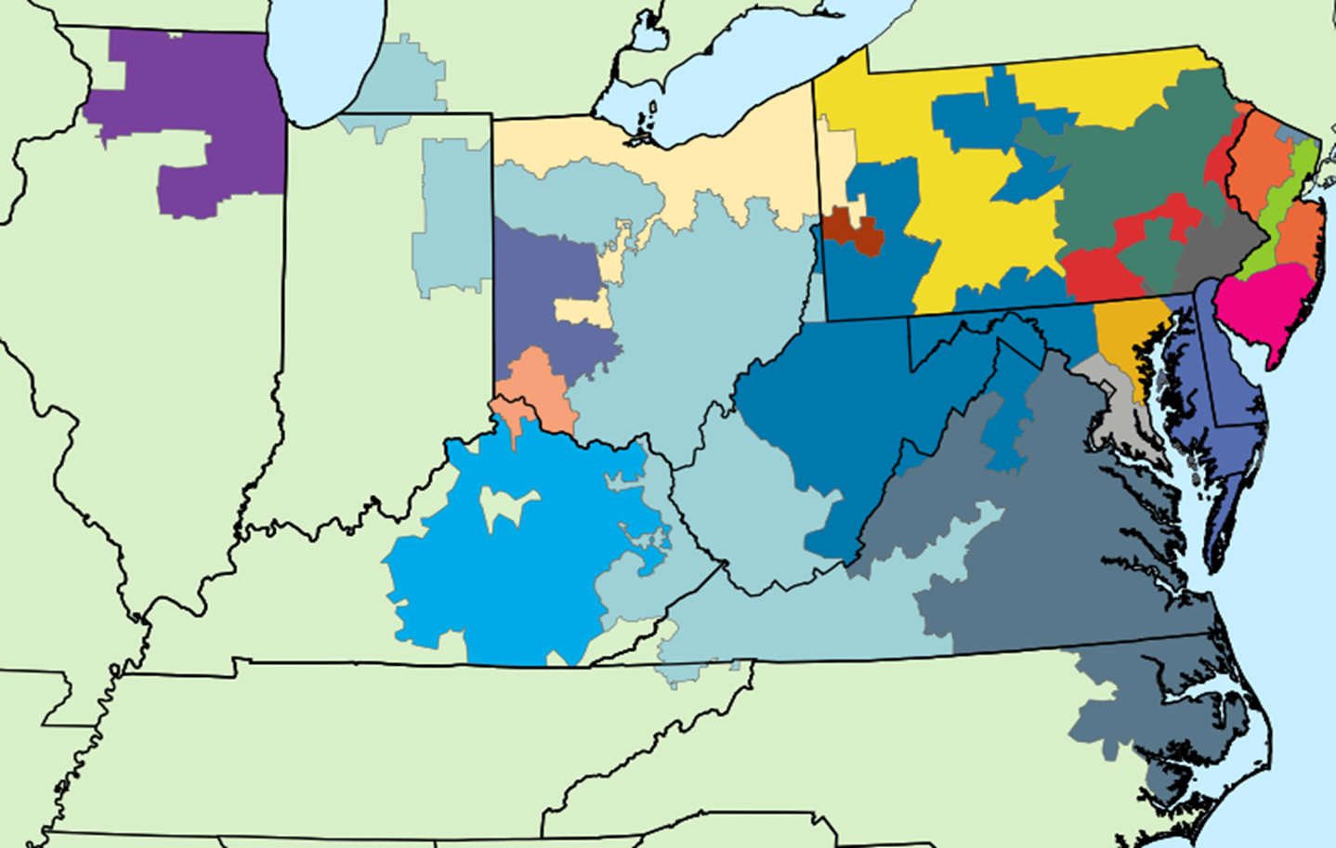
PJM Regional Transmission Operator (RTO)
FirstEnergy
/ ATSI
Notes:
Change name and placement of orange circle to show load LMP point.
Load LMP listed in S:\PLANNING\Key Files\contracts1.xls Congestion Tab Cells S5:W200

Slide 24
PJM – Installed Capacity
PJM is responsible for providing for adequate generation (installed capacity) to supply power during peak load conditions
Capacity costs are the monies paid to generation companies to ensure they maintain sufficient capacity so customers are guaranteed service.
PJM’s Reliability Pricing Model (RPM) market used to acquire Installed Capacity through annual auction
Load pays for PJM’s payments for Installed Capacity
$10 billion dollars per year
Notes:
Nothing needs changed on this slide.

Slide 25
RPM (Reliability Pricing Model)
PJM runs RPM Auction 3 Years in Advance (each May)
Jun 2015-May 2016 auction took place in May 2012
Capacity Market (as well as Energy Market) is a marginal market
  Cost for entire market is determined by the cost of the last unit needed, aka the marginal cost
    Last unit is the highest priced unit that is needed to cover load
Members receive RPM credit for:
  Generation Resources (NYPA, Landfill)
  Demand Response
Notes:
Nothing needs changed on this slide.

Slide 26
Capacity Costs
2015-2016 RPM auction was greatly affected by the closure of 4 coal-fired plants in the ATSI zone
Capacity costs will become the second largest expense in the electric bill for customers in the First Energy zone.
Impact of capacity costs range from 1.5 to 7.0 cents per kWh depending on location:
http://northshoreenergy.com/wp-content/uploads/2015/01/Capacity-Whitepaper-ATSI_10-01-20131.pdf
http://www.brakeyenergy.com/wp-content/Brakey_Energy_FirstEnergy_Capacity_White_Paper.pdf
https://static1.squarespace.com/static/50bfb146e4b07c2d6da6883b/t/51000687e4b054dfaf042133/1358956167572/Capacity-Costs-Survival-Guide.pdf
Notes:
Nothing needs changed on this slide.

Slide 27
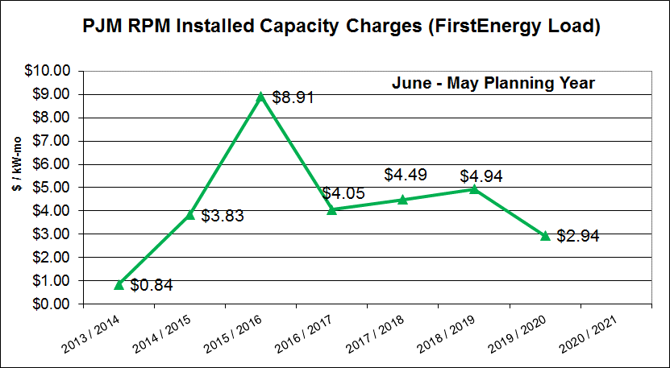
Notes:
For all Pennsylvania members that are not in PPL.

Slide 28
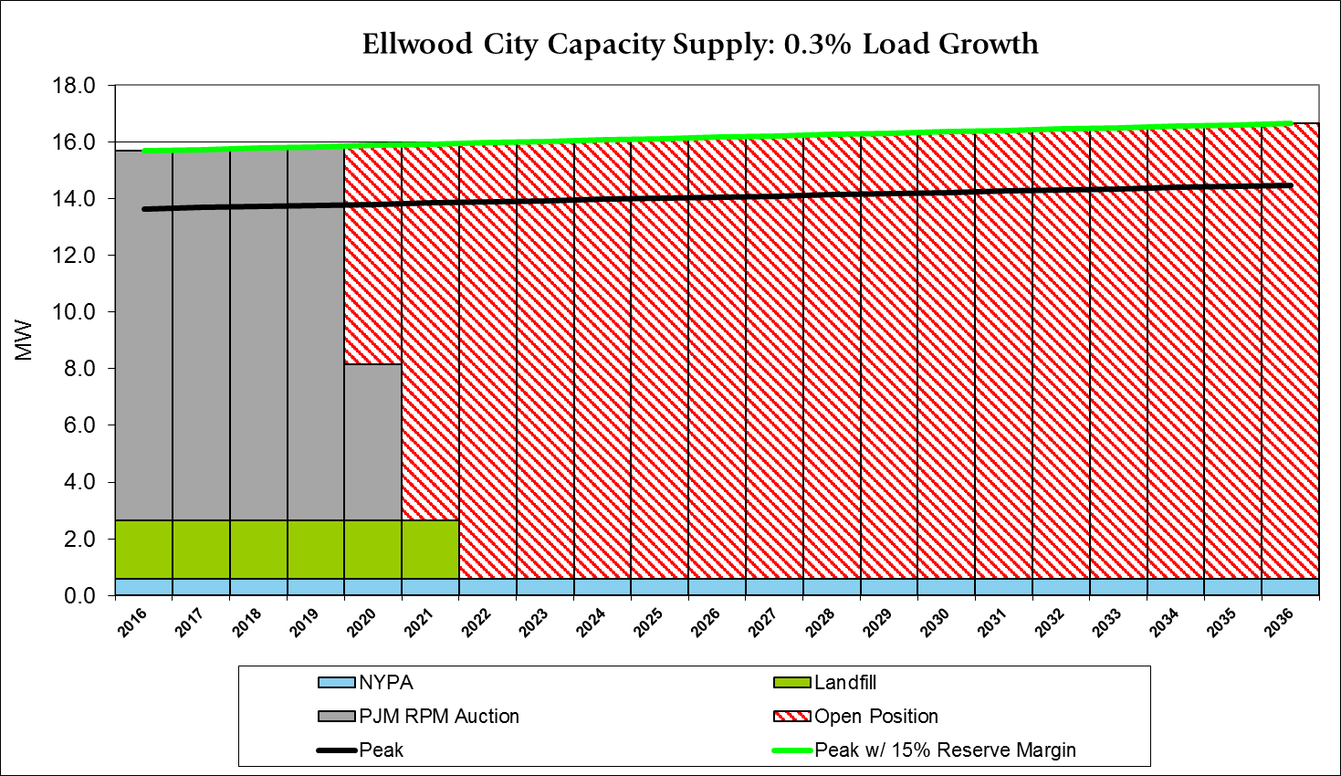
Notes:
S:\PLANNING\Key Files\Capacity Long Term Needs and Purchase Strategy.xlsm
Type in the muni name in C33, give it a second to refresh, then hit the “unhide rows” button, then the “hide rows” button.
Copy graph.
To paste on slide, Paste as Picture
Resize the graph to fit on the page (see example above)

Slide 29
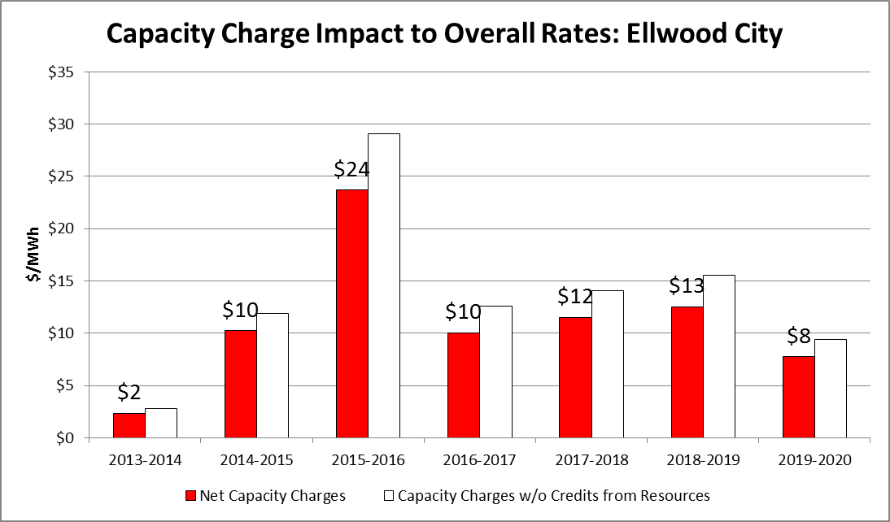
Notes:
Open S:\PLANNING\Key Files\Capacity Charges and Credits Comparison.xlsx
- Do Not Update
- Type Muni Name in Cell C2 on the “User” tab
- Chart will update
- Copy and paste as picture

Slide 30
Transmission Costs
Regional electric lines connecting generators to municipal system
20 transmission zones within the PJM territory
ATSI/First Energy zone is one of the most expensive zones in the PJM RTO
Notes:
Nothing needs changed on this slide.

Slide 31
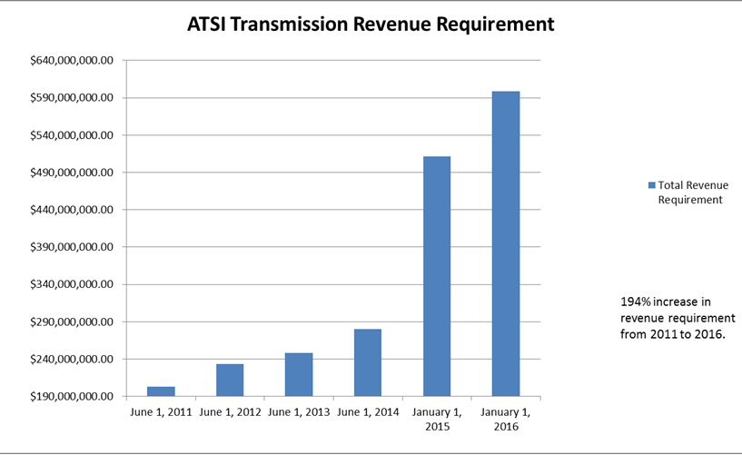
Notes:
Change name and placement of orange circle to show load LMP point.
Load LMP listed in S:\PLANNING\Key Files\contracts1.xls Congestion Tab Cells S5:W200

Slide 32
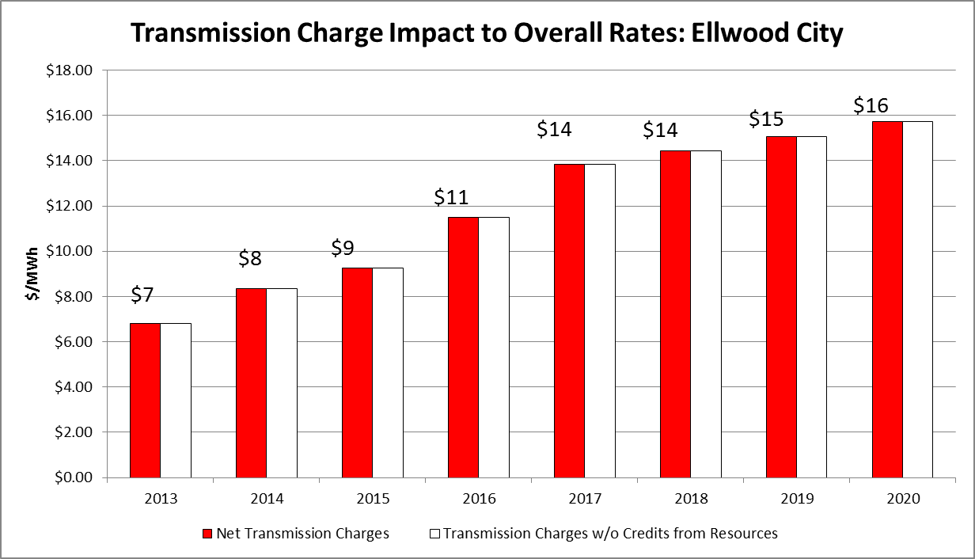
Notes:
Open S:\PLANNING\Key Files\Transmission Charges and Credits Comparison.xlsx
- Do Not Update
- Type Muni Name in Cell C2 on the “User” tab
- Chart will update
- Copy and paste as picture

Slide 33
Ellwood City’s Power Resources

Slide 34
Energy Market
Energy Market (as well as Capacity Market) is a marginal market
  Cost for entire market is determined by the cost of the last unit ($/MWh), aka the marginal cost
  This unit is the highest priced unit that is needed
  Electric power prices are closely tied to natural gas prices due to the numerous natural gas generating units setting the market price
Notes:
Nothing needs changed on this slide.

Slide 35
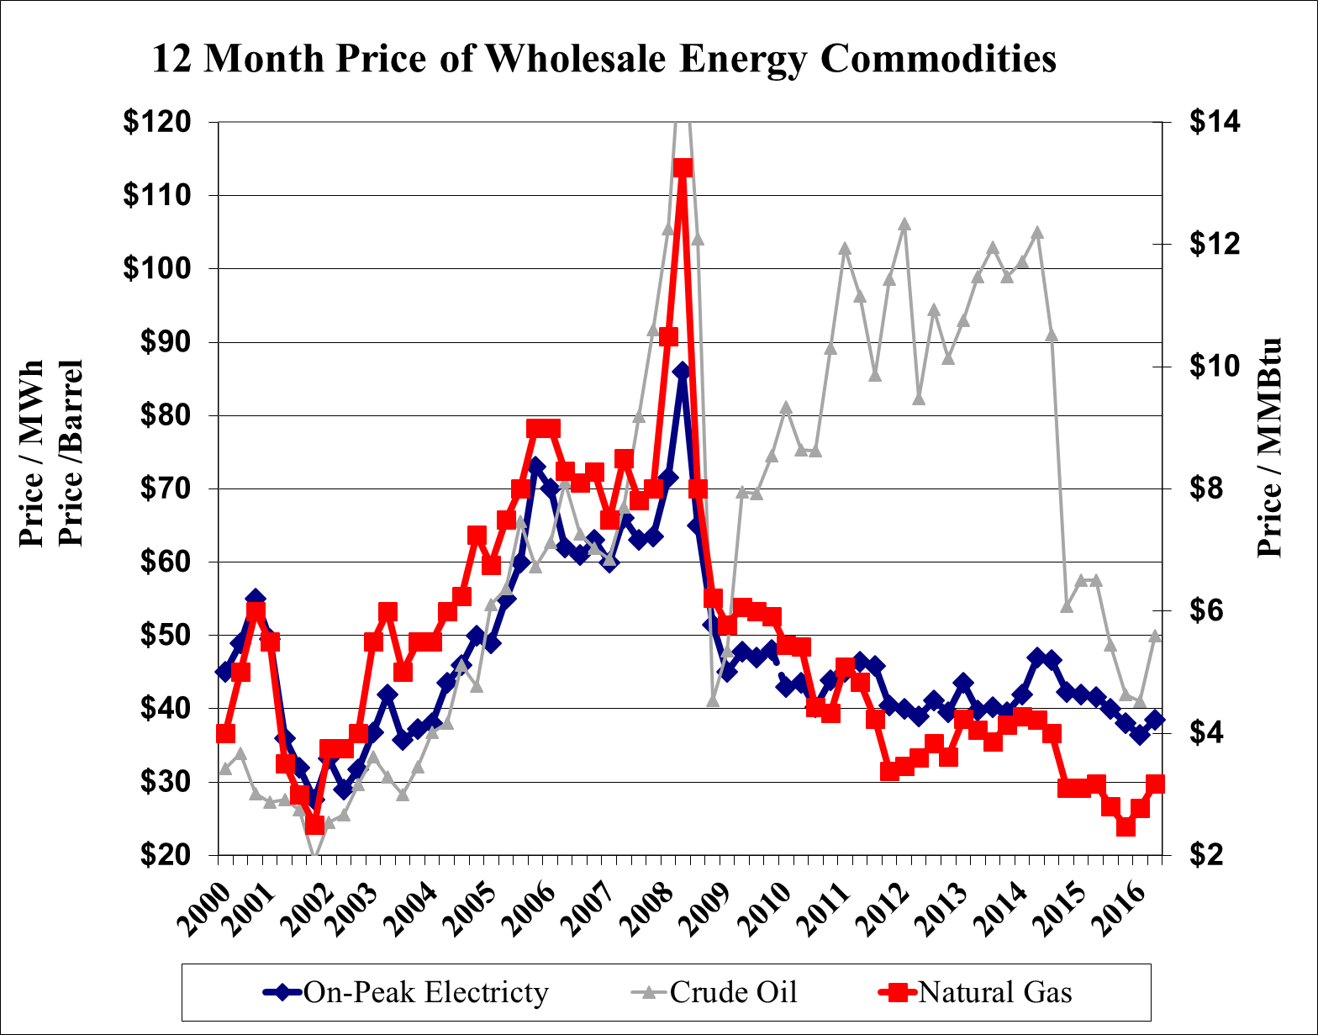
Notes:
Nothing needs changed on this slide.
Updated 1/19/16 Key Files > nextyearpricegraph.xls

Slide 36
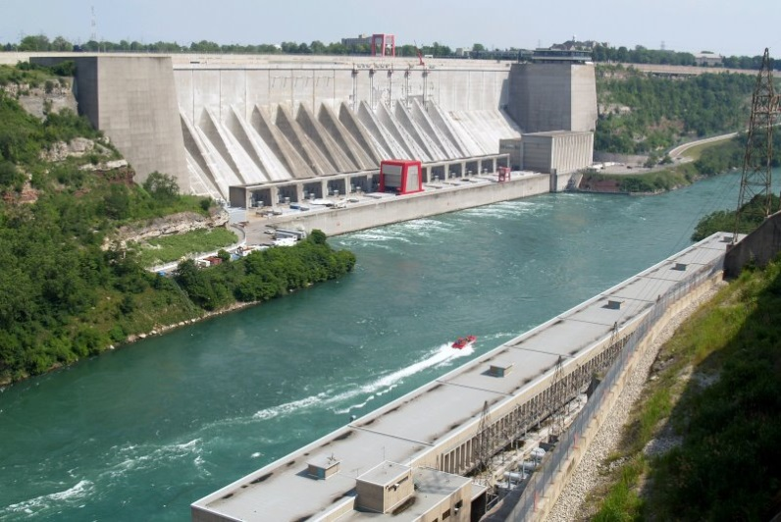
NYPA Power
New York Power Authority
Power comes from two federal hydro projects in New York (Niagara Project and St. Lawrence Project); License extended through 2027
NYPA power contains Capacity
Ellwood City Receives Approximately
0.6 MW (Varies Based on Water
Conditions)
Approximate Cost = $25/MWh
Notes:
Pennsylvania member?
If no, delete this slide
If yes, please update:
Muni name
Get 2013 average from CONTRACTS1 file, NYPA tab, cells M3:O125.
Open S:\PLANNING\Capacity Plans\pool/member\2013\pool/member2013Summary.xls
Monthly Charts Tab- Find Member Actual
- Select NYPA demand in column E
- Press F2, replace MAX with AVERAGE in the beginning of the formula, press enter
- record the average on slide
- close file, DO NOT save the file
-
Open G:\PWRSALES\New Energy Accounting\Select Most Current Year\Select Most Current Month\Select Correct Pool Billing File
Find tab that has “Detail” in the name
Find the invoice NYPA invoice and copy the same information from above by hiding the unnecessary rows
Paste Special-> Picture in slide to replace existing NYPA invoice

Slide 37
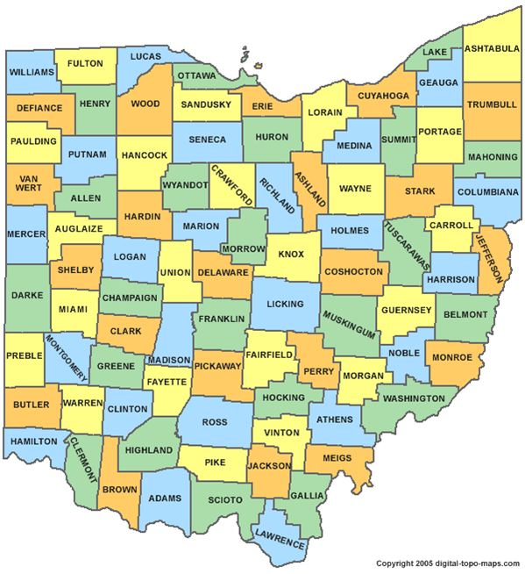
EDI Landfill Gas Project
53.8 MW of unit firm capacity and energy
2.740 MW Ellwood City
Power delivered from three landfills in FirstEnergy sold by Energy Development Inc. through Dec. 2021
Members receive installed capacity credits
Approx. Cost $60/MWh
  Variable
Ottawa County
Landfill
Port Clinton
Lorain County
Landfill
Oberlin
Carbon Limestone
Landfill
Poland
Notes:
On this slide, please change:
Check on next slide, to see if the muni purchases Landfill Gas.
If no, delete this slide.

Slide 38
Ellwood City’s Energy Purchases
2 MW Morgan Stanley (2013-2017) - $54.40/MWh
  Purchased 7/30/2009
  7x24 = Base Load Power (7 Days a week / 24 hours a day)
Exelon Remaining Requirements (Mar 2015-2020) - $44.18/MWh
  Purchased 2/18/2015
  Balance of Borough’s Needs
7x24
Other
Notes:
Open S:\PLANNING\Databases\Short File Database
Click “Queries\Reports”
Under “Member Query” in the “member” line type in the Muni name, then click either preview report or print report, whichever you prefer.
All purchases should be included on this slide.
Place non 7x24 contracts and Remaining requirement deals under “Other”
Do not include assets like NYPA, SEPA, Gorsuch, JV5, Landfill, JV1, JV2, AMPCT, etc.
Change format as needed to fit resources on page
Include delivery point for each contract

Slide 39
Morgan Staley 7x24 Purchased
Remaining Requirements Purchased
EDI Landfill Purchased
Notes:
Nothing needs changed on this slide.
Updated 1/19/16 Key Files > nextyearpricegraph.xls

Slide 40
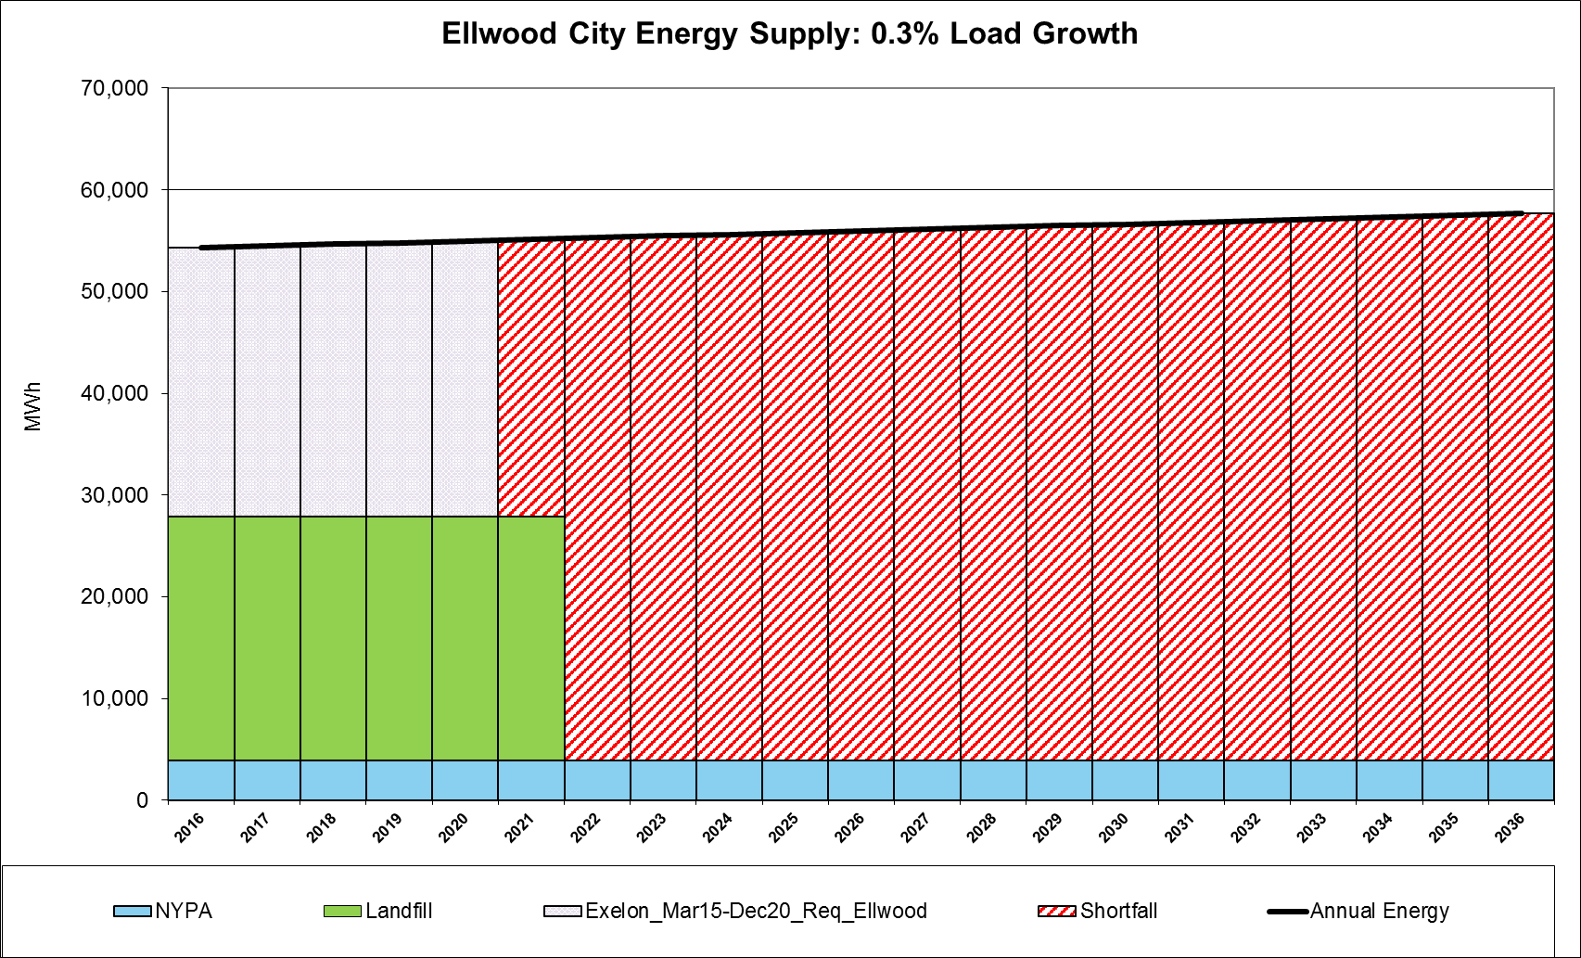
Notes:
S:/PLANNING/Key Files/Energy Graphs.xlsm
Type in the muni name, give it a second to refresh, then hit the “unhide rows” button, then the “hide rows” button.
Copy graph.
To paste on slide, Right-click -> Paste Special -> Picture
Resize the graph to fit on the page (see example above)

Slide 41
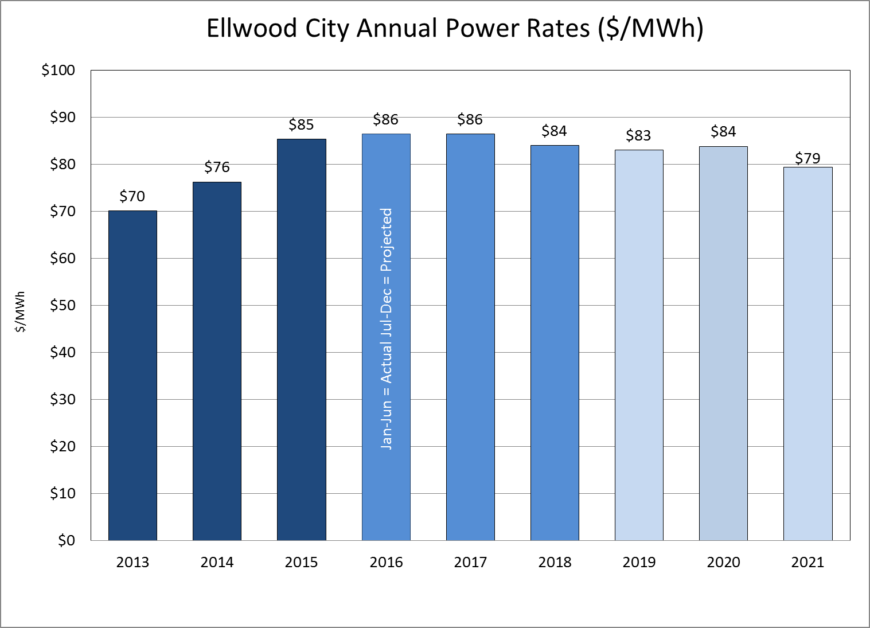
Notes:
S:\PLANNING\Key Files\Power Rates.xlsm
Do NOT Update
Change Muni Name in cell C2 and graph should update automatically
Copy graph and Paste as Picture

Slide 42
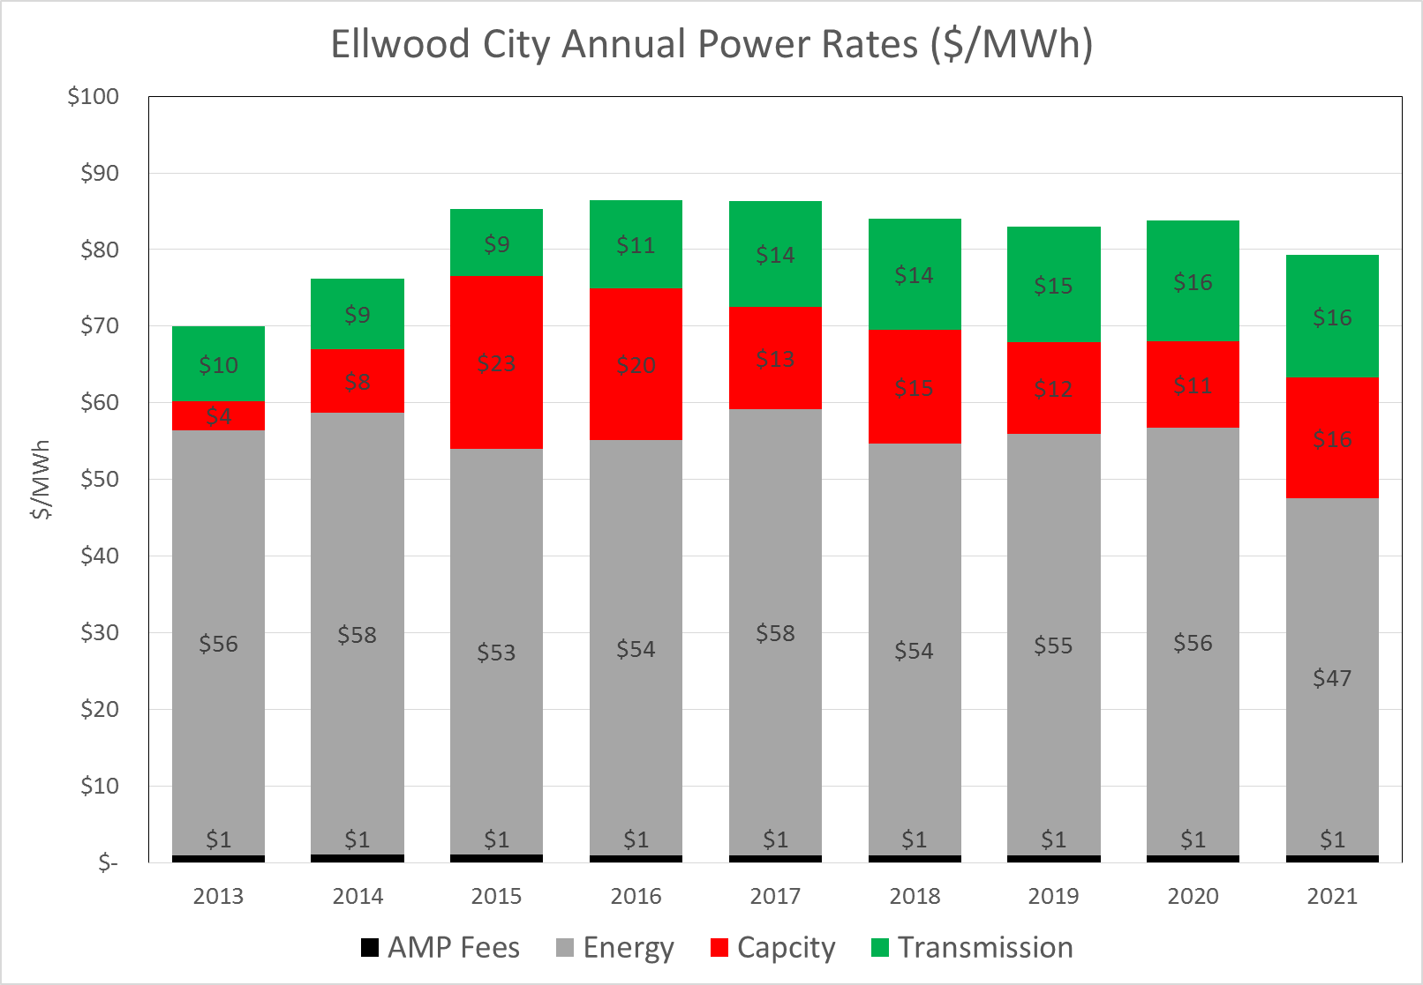
Notes:
S:\PLANNING\Key Files\Power Rates.xlsm
Do NOT Update
Change Muni Name in cell C2 and graph should update automatically
Copy graph and Paste as Picture

